Slide 1
Graphs for Presentation
Tanmay Gupta

Slide 2
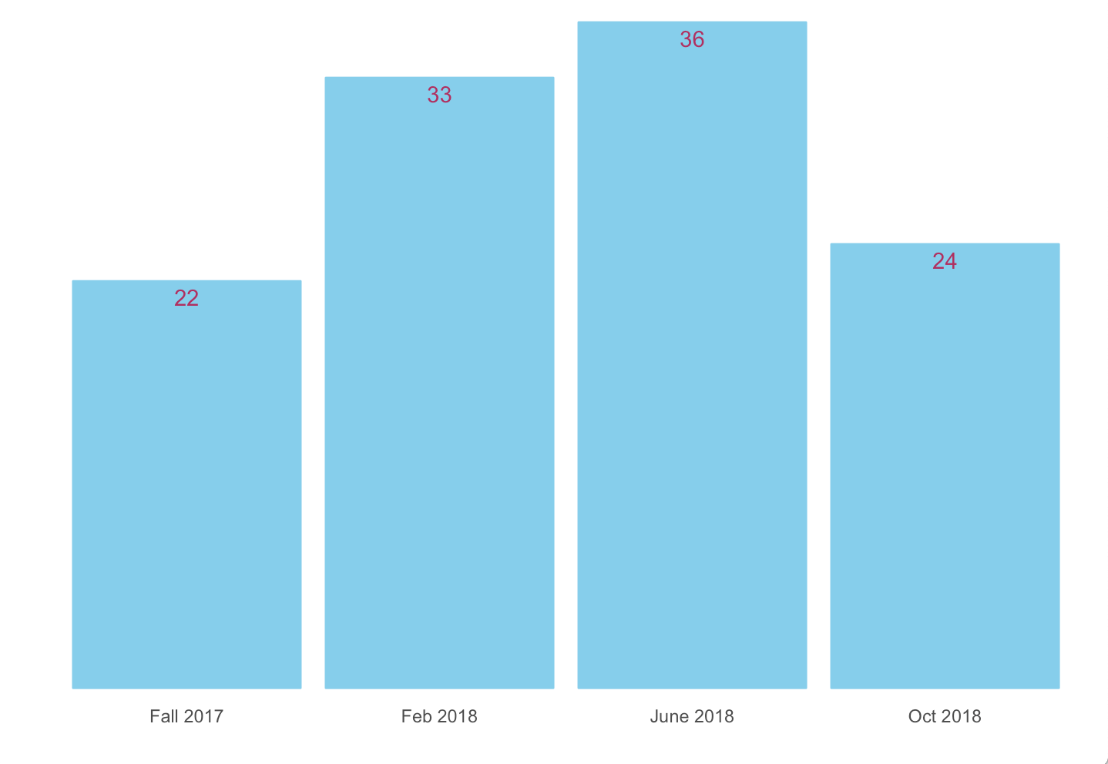
Hospitals per Cohort

Slide 3
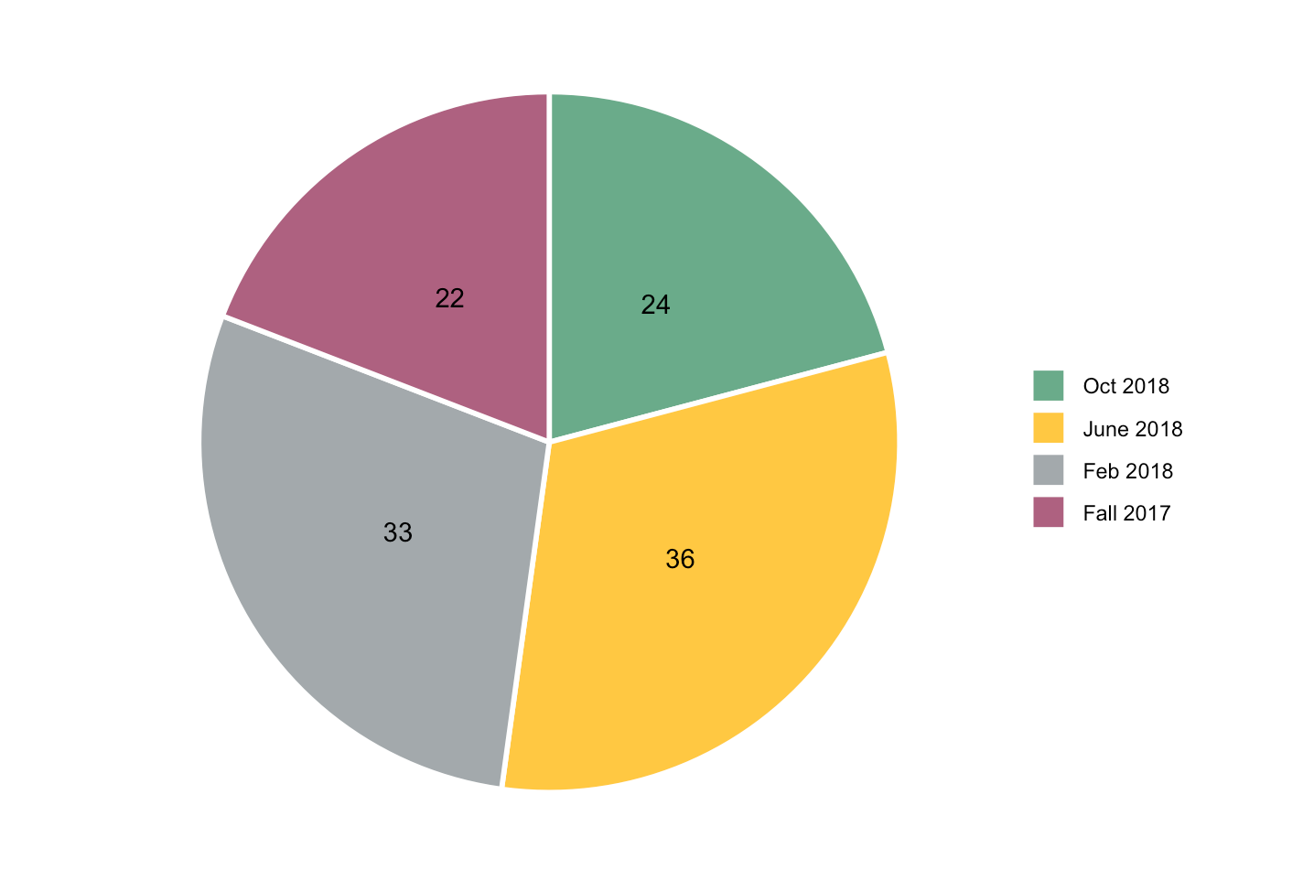
Hospitals per Cohort

Slide 4
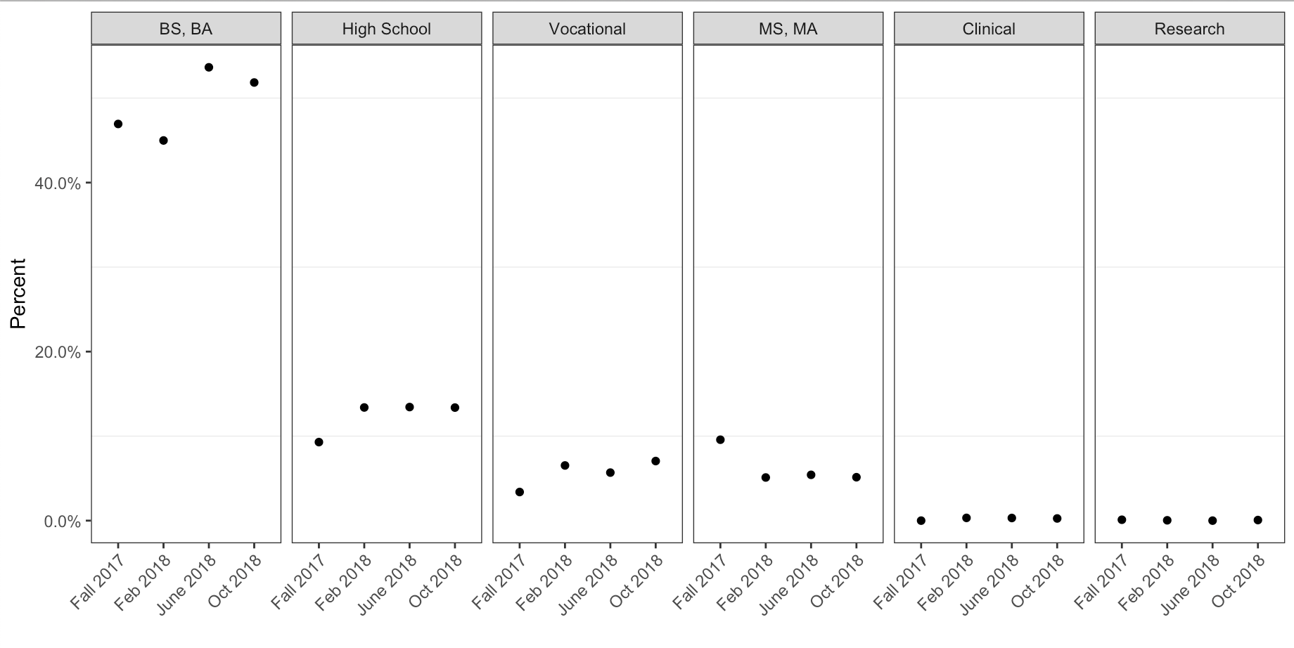
Education Level by Cohort

Slide 5
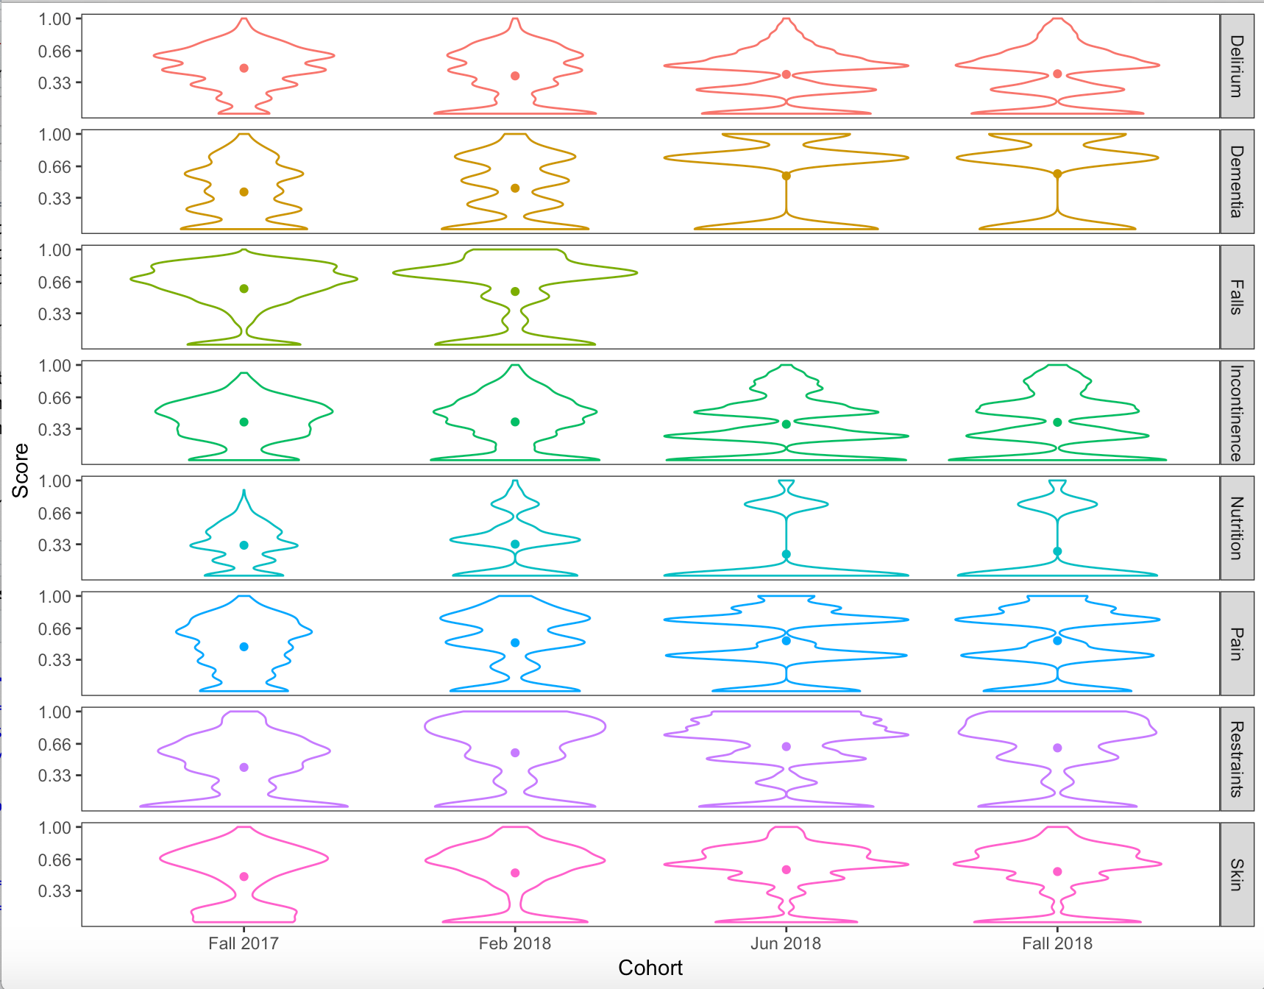
Knowledge Distribution
by Cohort

Slide 6
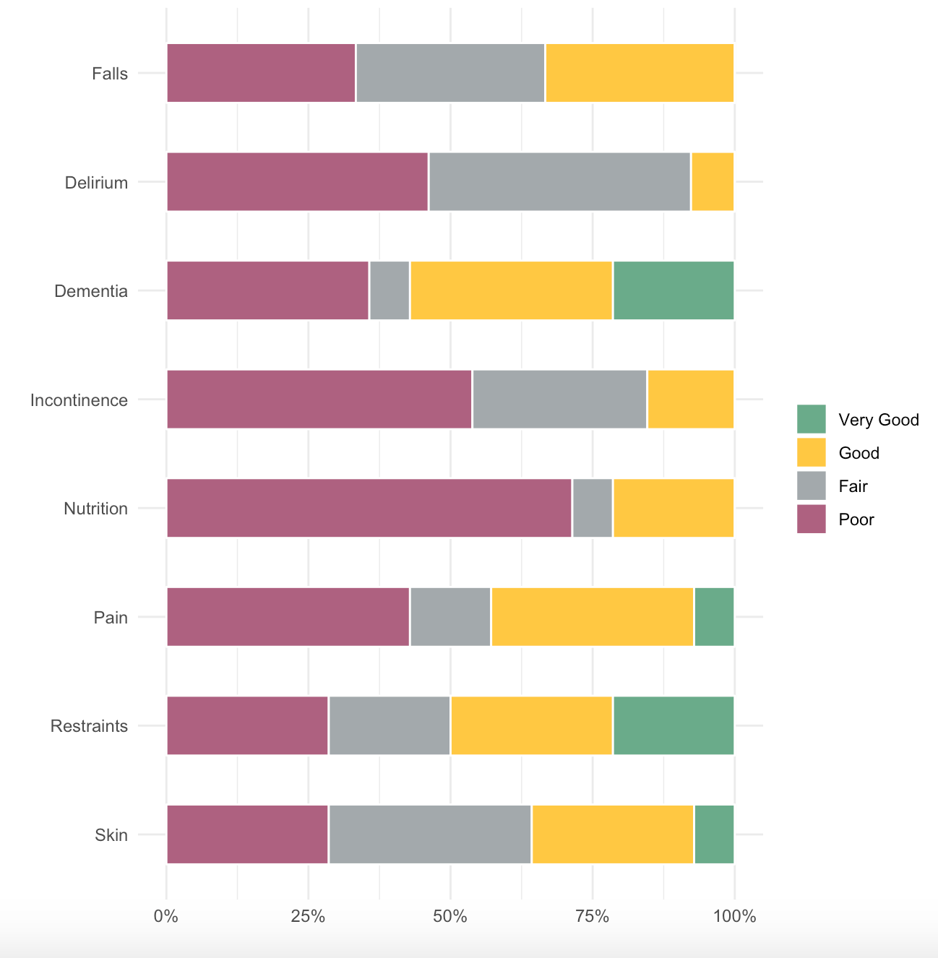

Slide 7
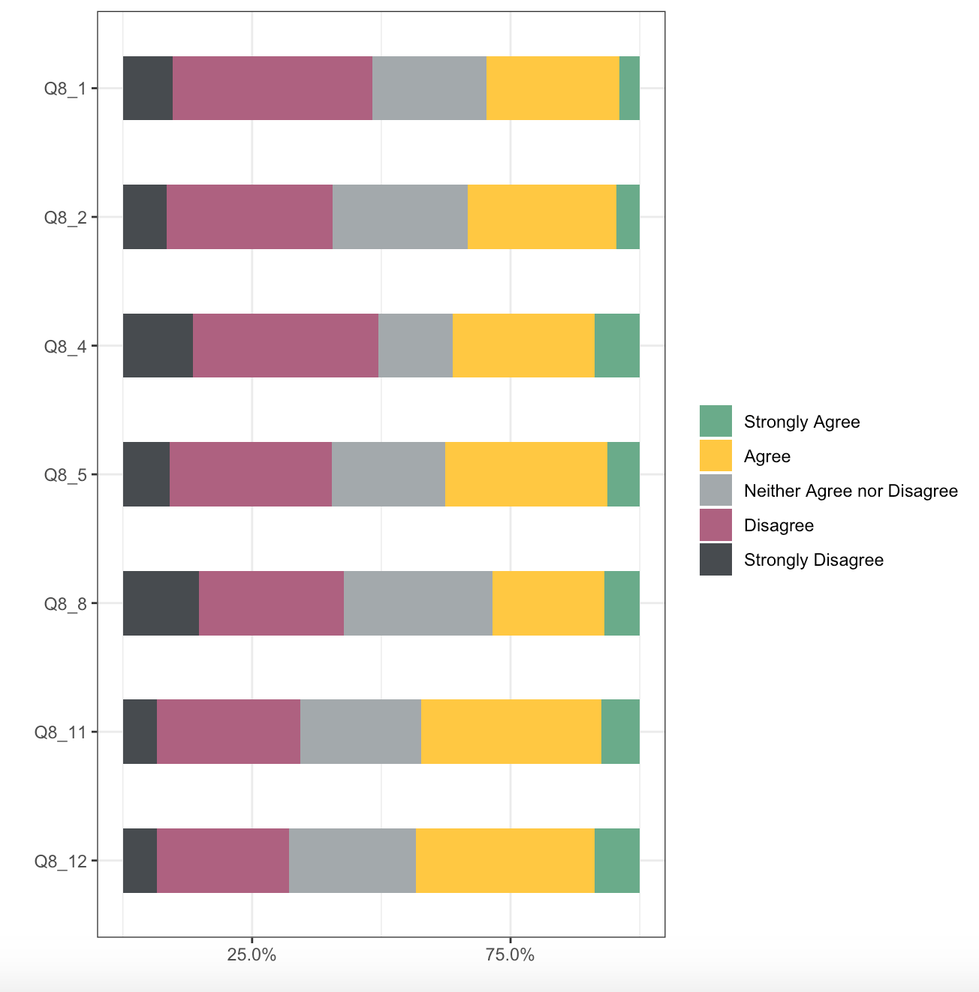
Organizational Values

Slide 8
Code | Question
Q8_1 | Lack of knowledge about care of older adults
Q8_2 | Lack of (or inadequate) written policies and procedures specific to the older adult population
Q8_4 | Lack of specialized equipment (eg: raised toilet seats, bed alarms, mattresses or beds)
Q8_5 | Lack of specialized services for the older adult
Q8_8 | Pressures to limit treatment based on insurance reimbursement
Q8_11 | Communication difficulties with older adults and their families
Q8_12 | Confusion over who is the appropriate decision maker for the older adult

Slide 9
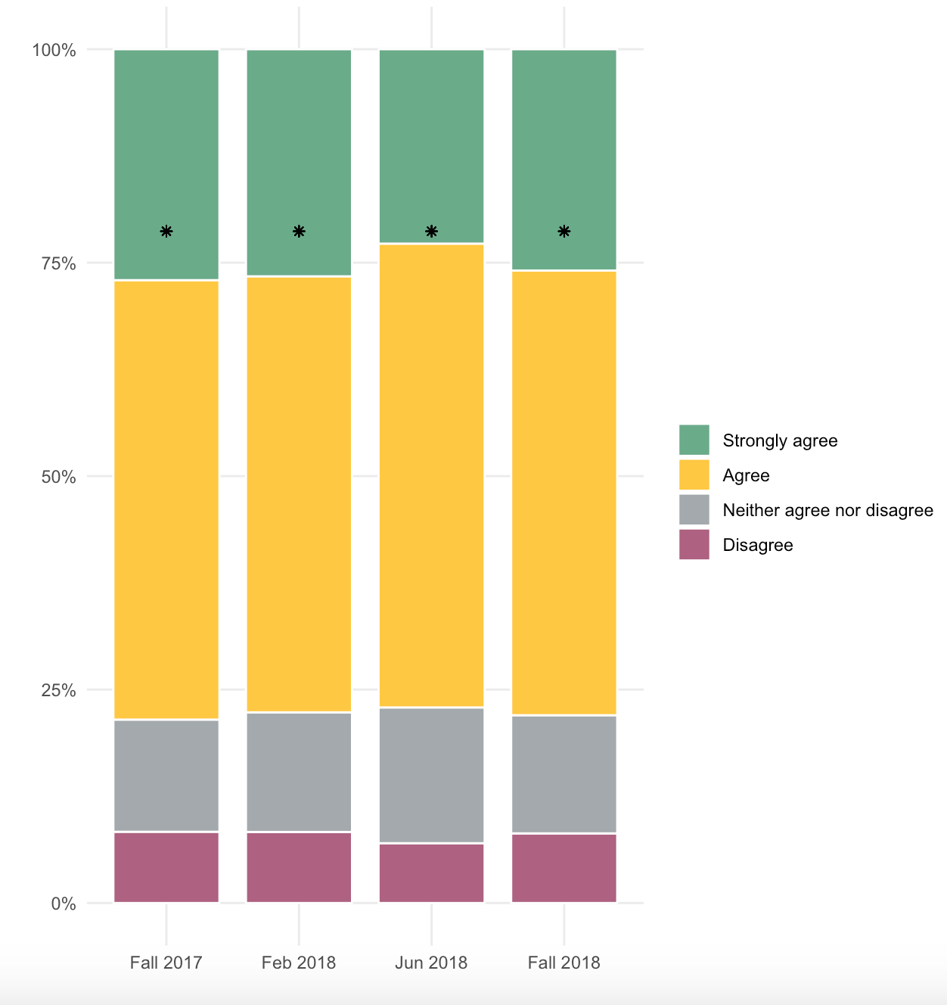
Nurse Job Satisfaction
by Cohort

